Slide 1
UBER Supply – Demand Assignment
Student : Jagadish Janakiraman
Date : 2/27/2022

Slide 2
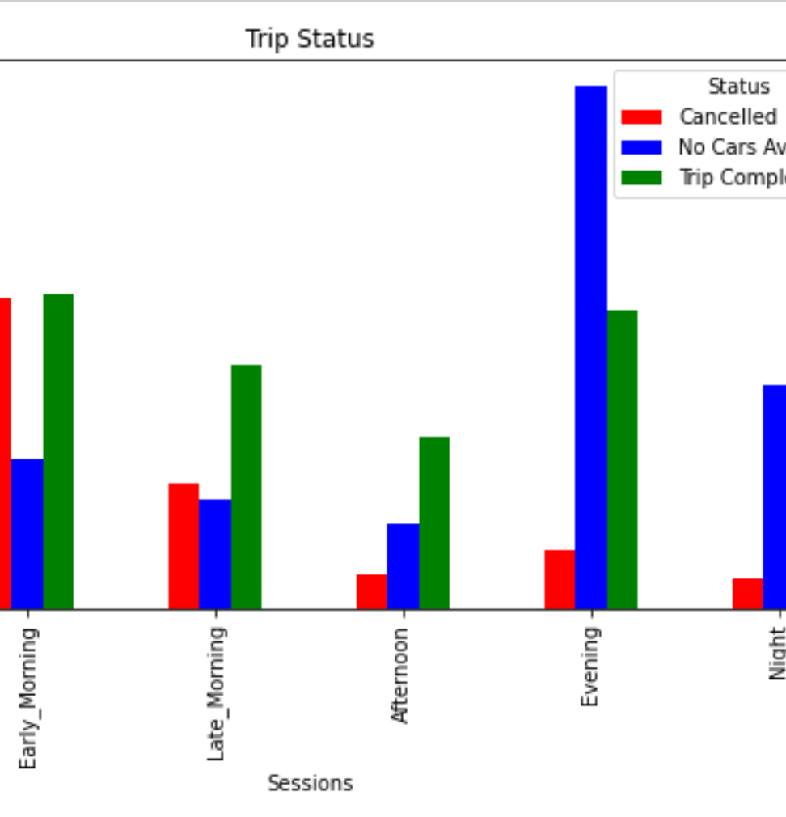
Problem Statement – Cancelled Trips and Availability of Cabs
Trip Cancellations
City to Airport - More Trips are cancelled in Early Morning between 4-8 AM & Late Morning between 8AM-12PM
Maximum cancellations are from City To Airport between 4 AM - 8 AM
No Cars Available
Airport to City – More unavailability observed between Evening 4-8 PM and Night 8PM-12AM
Maximum number of No car available trips is in the evening (4 PM to 8 PM) from Airport to City.

Slide 3
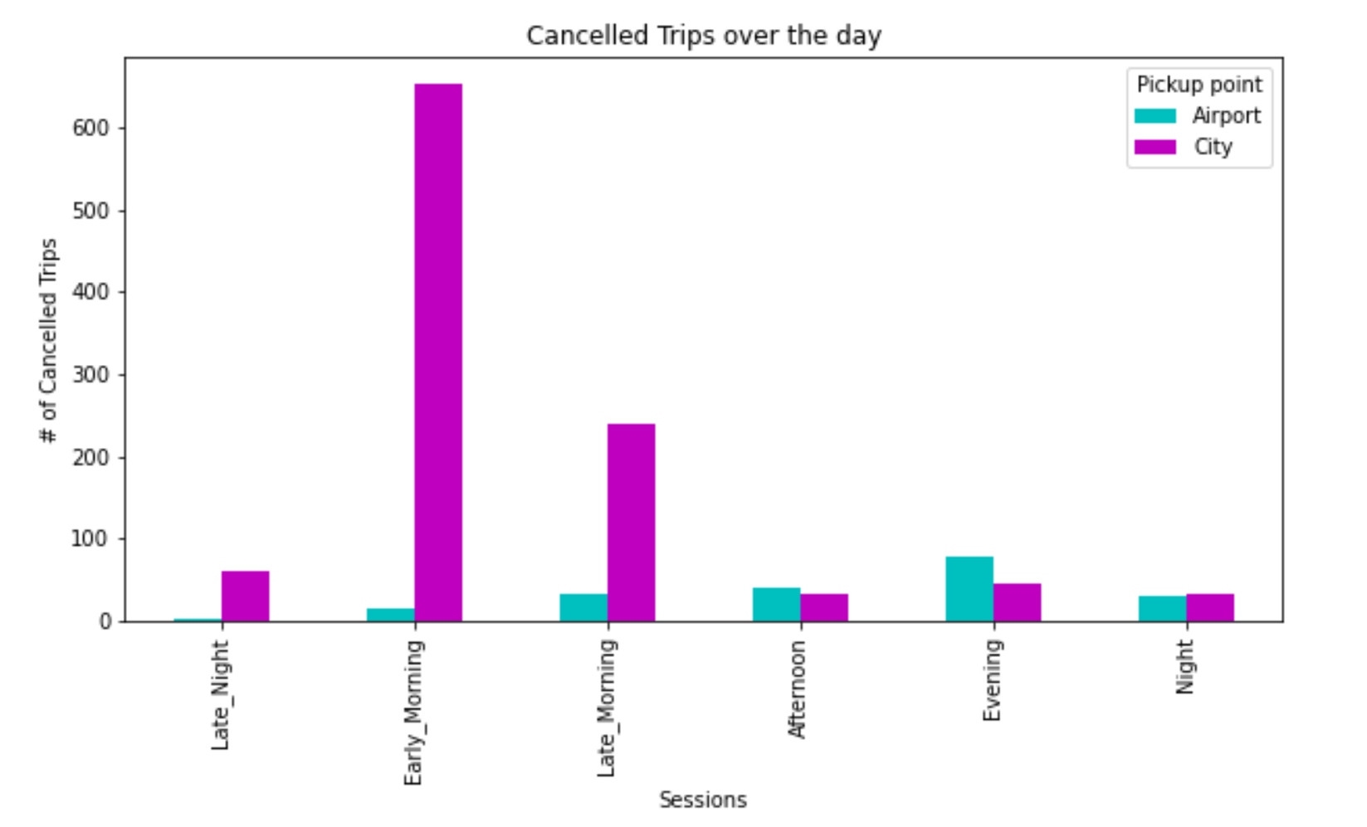
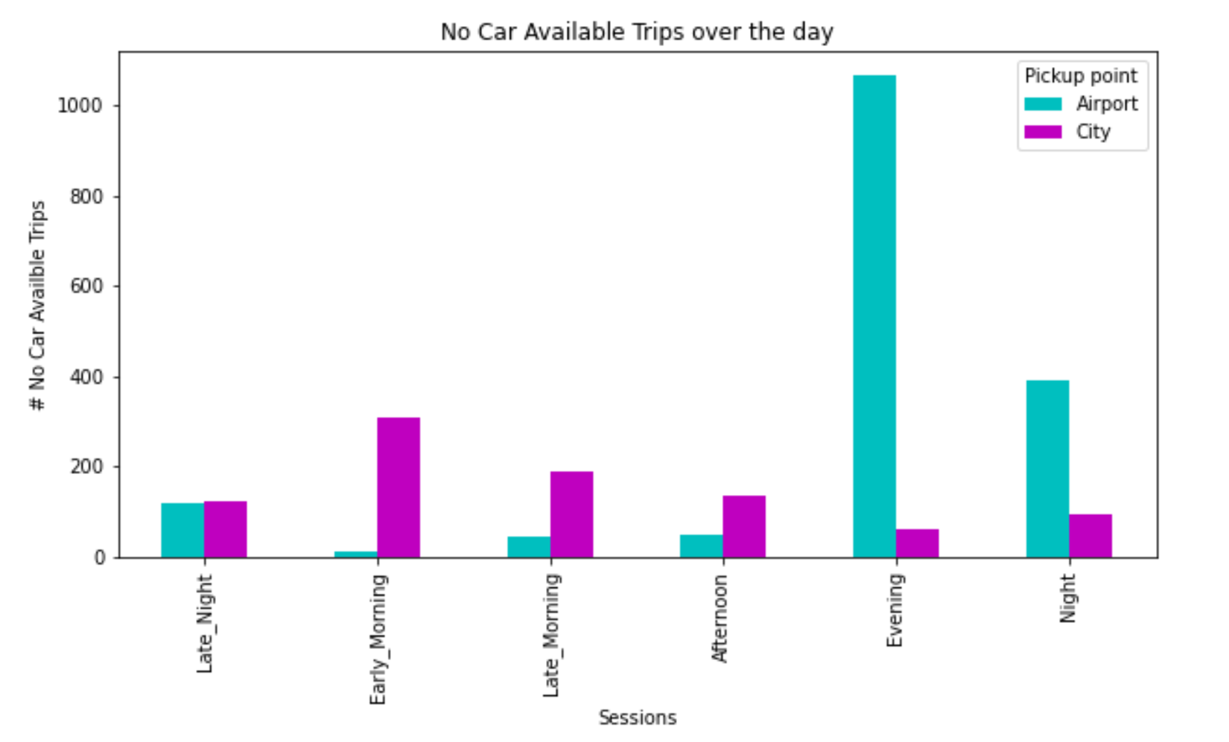
Cancelled Trips & Cars Availability
4:00 AM – 8:00 AM
Maximum cancellations observed from City to Airport in the early morning
4:00 PM – 8:00 PM
Maximum cabs unavailability observed from Airport to City in the evening 4 PM – 8 PM

Slide 4
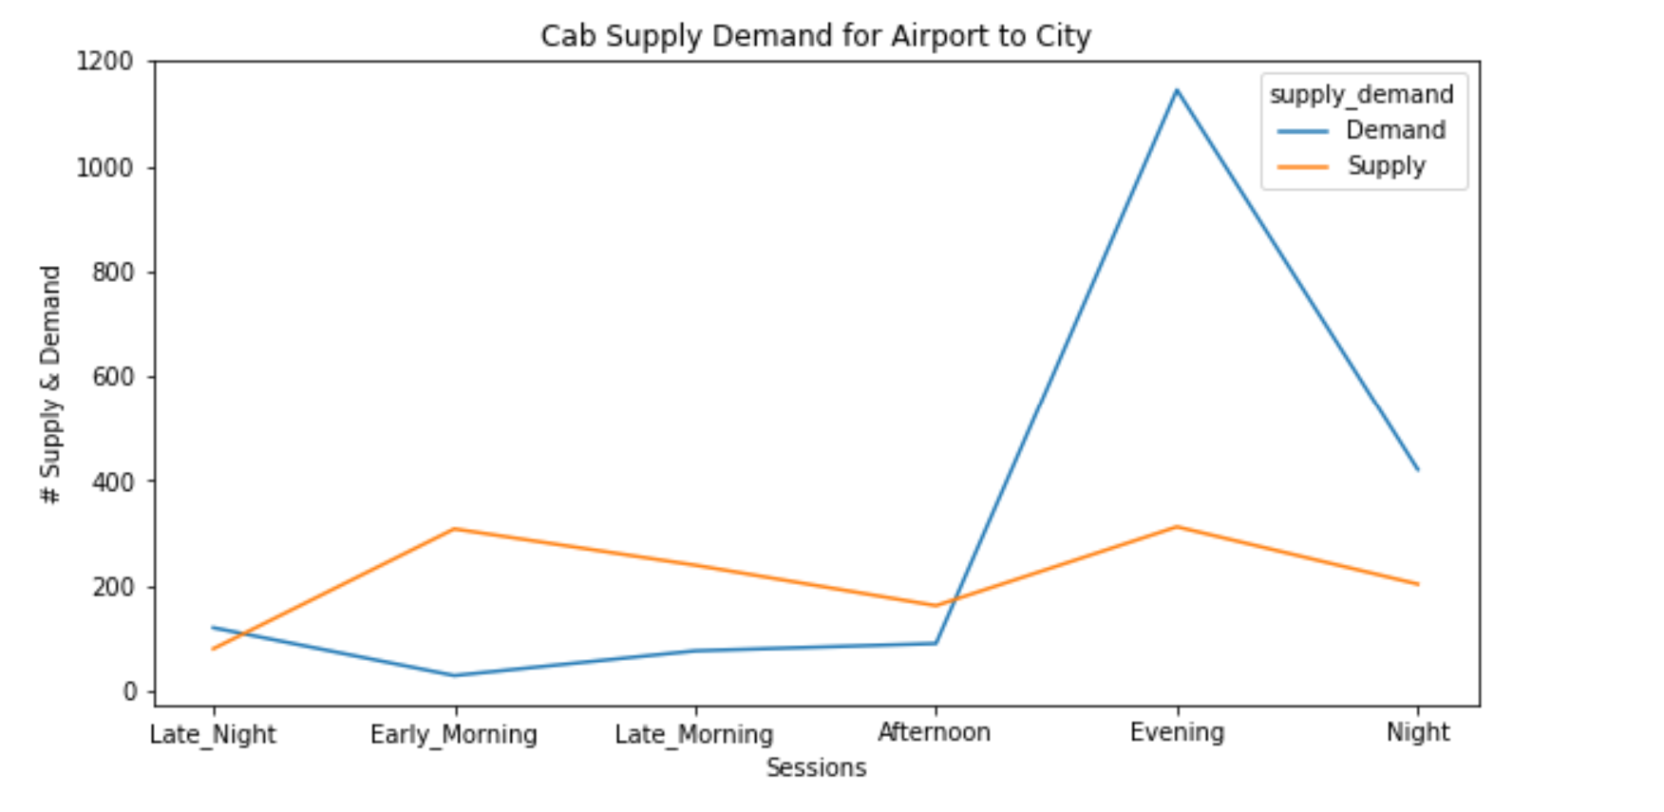
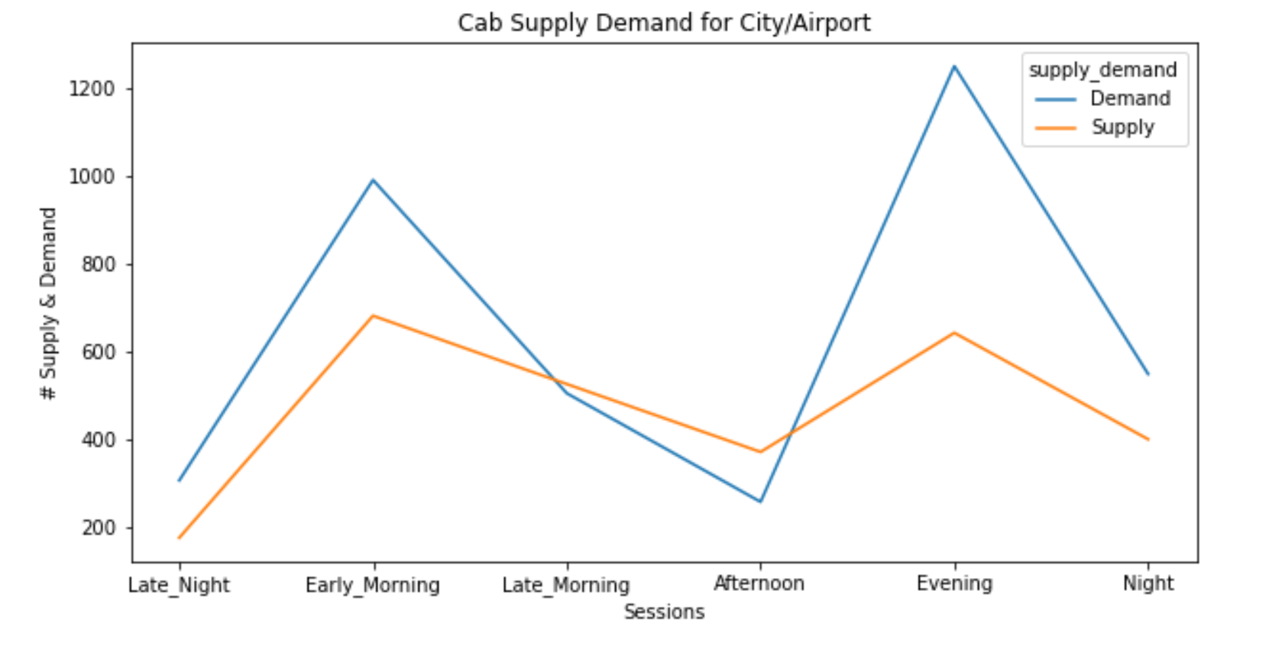
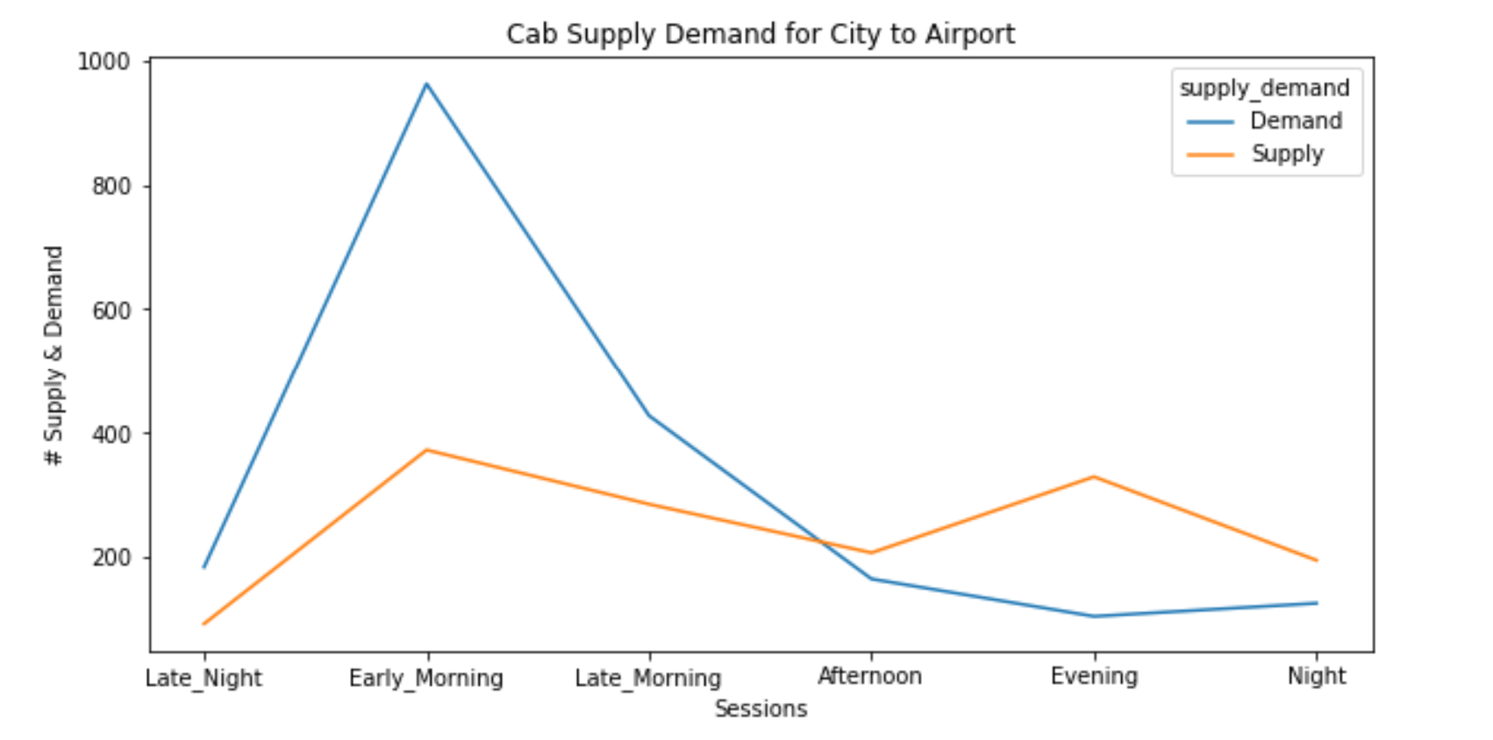
Supply Demand Gap
From Airport to City, Demand is higher at 1200 requests whereas supply is about 200 only in the evenings.
From City to Airport, Demand is higher at 1000 requests whereas supply is about 200 in the mornings.
Max of Supply is 600 and max of Demand in the morning is 1000. Similarly max of demand is 1200 whereas supply is 600 only.
Overall Supply is less than demand.

Slide 5
Recommendations to meet Supply vs Demand
Increase price in the Evenings From Airport to City and give bonus to drivers
Increase price in the Mornings From City to Airport and give bonus to drivers
Uber can give gas price during off hours to Airport and City for pickup without a ride

